Slide 1

Olympics Data Analysis
(1976–2008)
Domain: Data Analytics
Tools: Python (Pandas, Matplotlib, Seaborn), Jupyter Notebook, Excel.
Name: K.Sathvika

Slide 2
Project Objective
Analyze Olympic medal performance trends (1976–2008)
Identify top-performing countries & athletes
Highlight medal-dominant sports
Study gender participation patterns
Apply Python analytics & visual insights

Slide 3
Dataset Description
File: Summer-Olympic-medals-1976-to-2008.csv
Rows: 15,433
Columns: 11
Year Range: 1976–2008
Key Fields: Sport,Event, Athlete, Country(NOC), Gender, Medal
Note: Each medal = one record (team medals counted per athlete)

Slide 4
Data Cleaning
Removed missing values (117 rows)
Dropped unnecessary columns: Country_code, Event_gender
Applied str.strip() for text cleaning
Standardized Medal & Sport category labels
Removed duplicates
Final Records: 15,316

Slide 5
Exploratory Data Analysis
Analyzed medal distribution across all Olympic years (1976-2008)
Identified top medal-winning countries and their performance trends
Examined male vs female participation and medal achievements
Reviewed most successful sports contributing to medal counts
Observed year-wise medal fluctuations and overall Olympic growth

Slide 6
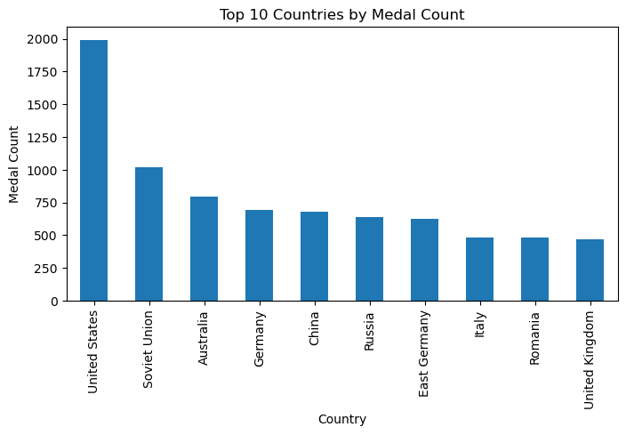
1. Top Countries by Total Medals
USA consistently ranked #1 in overall medal count
Russia/USSR showed strong multi-game dominance
China and Germany showed steady global rise
Japan & Australia emerged as competitive mid-range nations
Clear performance gap between top 5 and remaining countries

Slide 7
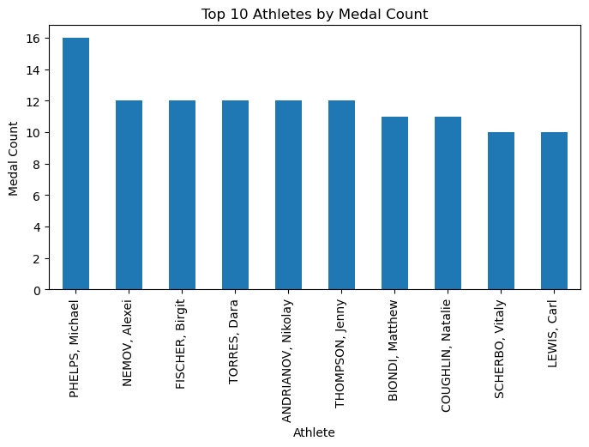
2. Top 10 Athletes with Most Medals
Michael Phelps leads with 16 medals
Alexel Nemov, Birgit Fischer, Dara Torres among top performers
Top athletes concentrated in Swimming & Gymnastics
Individual dominance contributes strongly to country totals

Slide 8

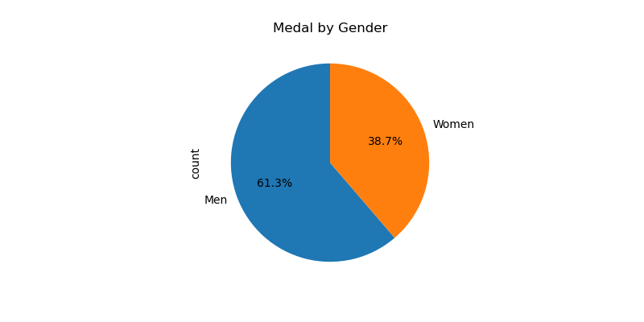
3. Gender Participation Analysis
Male athletes recorded higher participation & medal counts overall
Female representation showed steady increase across years
Noticeable rise in female medals after 1992
Gender gap reduced gradually, indicating improved inclusivity
Male dominance persists but overall participation trend is balancing

Slide 9
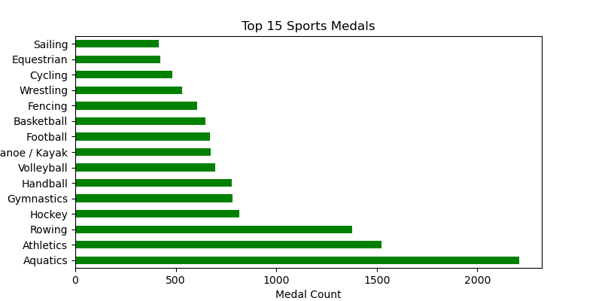
4. Top Sports by Medal Count
Athhletics & Swimming contributed the highest share of total medals
Gymnastivs & Rowing showed consistent strong performances
Team sports showed lower overalll medal colume compared to individual events
Clear dominance observed in endurance and skill-based categories

Slide 10
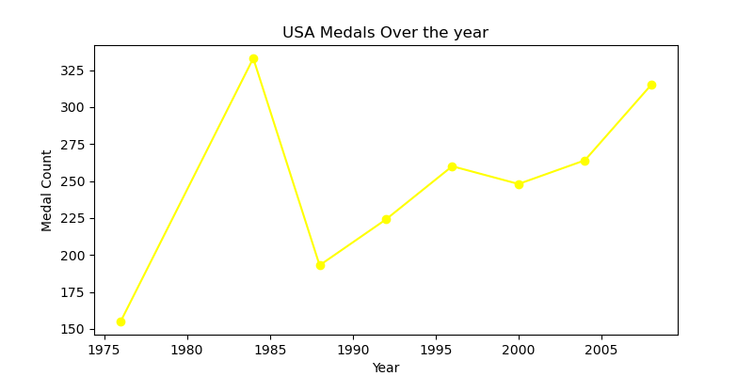
5. Country-Specific Performance (USA)
USA consistently remained the top medal-winning nation
Maintained stable performance trend across all Olympic years
Dominance observed in Athletics, Swimming, and Gymnastics
Medall gap between USA and other countries remained significant
Performance reflects long-term sports investment and coaching excellence

Slide 11
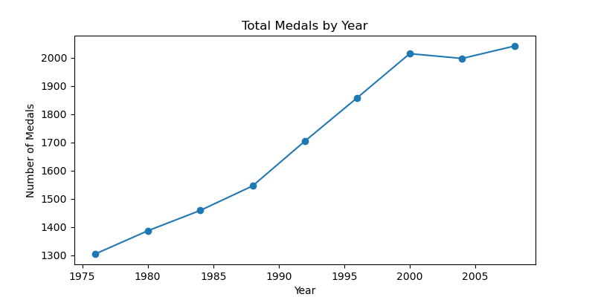
6. Year-wise Medal Performance Trends
Total medal counts increased over time, showing overall Olympic expansion
Slight drops observed during specific years due to events participation changes
Consistent upward trend reflrcts improved global competition
Growth driven by increased country participation & sport categories

Slide 12
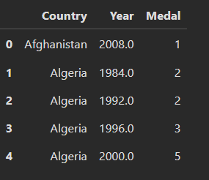
7. Total Medals by Each Country per Year
Medal counts differ significantly across participating nations
Some countries show gradual improvement over Olympic years
Algeria demonstrates steady growth in medal tally post-1990s
Afghanistan recorded minimal participation with limited medals
Highlights variation in national Olympic performance per edition

Slide 13
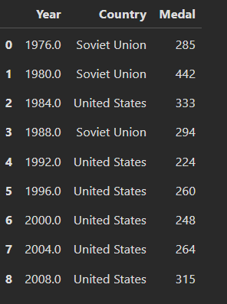
8. Top Country Achievement by Olympic Year
USA & USSR alternated leading medal positions across Olympic years
USSR dominated prior to 1992, while USA led consistently from 1996 onward
China, Australia & Germany emerged as strong competitors post-2000
Shift in medal leadership reflects evolving global sports performance
Highlights changing competitive landscape across Olympic editions

Slide 14
Key Insights
USA consistently dominated medal wins throughout 1976-2008.
Female participation showed steady growth across Olympic years.
Athletics and Swimming remained top medal-contributing sports.
Overall meda counts increased over years indicatig stronger global competition.
China and Russia showed sharp performance rise in later years.

Slide 15
Conclusion
Analysis provided clear trends in medal distribution and country dominance
Identified growth patterns in women’s participation and medal achievements
Highlighted leading sports driving medal success
Dataset insights support understanding of Olympic performance evolution

Slide 16
Thank You

